Slide 1
Meet Delta Dental
Iowans Supporting Iowans
Iowa Dental Association Webinar – May 2026

Slide 2
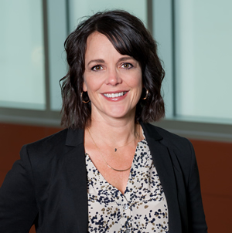
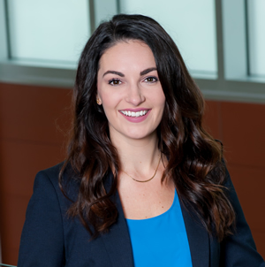
Focusing on Healthy Iowans for 55 Years
Over 55 years of experience in Iowa
Over 20 years of experience in Government Programs
Iowans serving Iowans
Established stakeholder relationships
Strong understanding of program requirements
Demonstrated ability to manage a diverse Iowa Medicaid population
Gretchen Hageman
VP of Government Programs
Nicole Miller
Director of Government Programs
Notes:
Hawki – 2004
DWP – 2014
DWP Kids – 2021
Our leadership team has extensive experience in the government programs space with Delta Dental of Iowa

Slide 3

Meet the Provider Relations Team

Slide 4
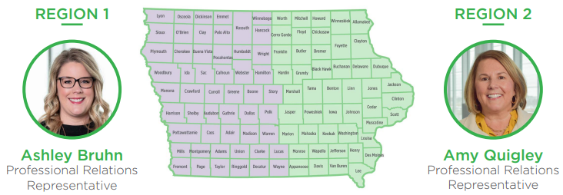
Provider Relations Contacts

Slide 5
Here to Support Your Practice
🤝 On-site office visits
📍 Local representatives who understand Iowa
💬 One-on-one support to answer questions and solve challenges
🧩 Office trainings: claims, provider portal, and administrative processes
💻 Easy-to-use provider portal and website
🔄 Ongoing partnerships
Contact us today to set up an office visit!
Email: provrelations@deltadentalia.com
Or email your representative, Amy or Ashley

Slide 6
Credentialing Process and Help
Certified by the National Committee for Quality Assurance (NCQA) in credentialing
Focus on a positive provider experience with the least amount of administrative burden for your office
Current Delta Dental turnaround time for initial applications is 5 days
Work collaboratively with the Iowa Medicaid’s enrollment team to support providers through the IM enrollment process
Contact: provrelations@deltadentalia.com

Slide 7
We are Here to Help!
Delta Dental Provider and Member Services are here to help you and your patients Monday through Friday from 7:30am to 6:00pm (CST)
Providers
Phone: 888-472-1205
Email: provrelations@deltadentalia.com
Website: deltadentalia.com/choice
Members
Hawki Phone: 800-544-0718
DWP and DWP Kids Phone: 888-472-2793
Website: smileia.com

Slide 8

MISSION
We are dedicated to improving the health and smiles of the people we serve.

